Slide 1
Neural Spike Sorting
Dr. Raied Salman
Erik Test
Advisor: Dr. Kecman
Gregory Smith
Advisor: Dr. Najarian
Virginia Commonwealth University
Computer Science Department

Slide 2
Introduction
Neural spikes indicate when a neuron in the brain fires
  Detected using micro-wires inserted in specified areas
  Since there are many neurons recorded at the same time, several neural spikes are recorded but it is difficult to determine what spike belongs to which neuron.

Slide 3
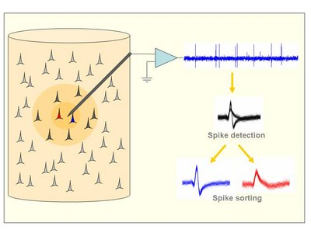
Introduction
Extracellular recordings are usually done by inserting microwires in the brain.
Spikes from neurons further apart cannot be detected and they contribute to
the background noise activity
It is already well established that complex brain processes are reflected
by the activity of large neural populations and that the study of single-cells
in isolation gives only a very limited view of the whole picture
(Brown et al., 2004; Buzsaki, 2004).
Spike sorting step by step
Spike sorting step by step
The continuous raw data is band-pass filtered, e.g. between 300 Hz and 3000 Hz.
Spikes are detected, usually using an amplitude threshold.
Relevant features of the spike shapes are extracted, thus giving a
dimensionality reduction.
4. These features are the input of a clustering algorithm that performs
the classification.

Slide 4
Introduction
Neural spiking is difficult to detect because:
  Background noise can 'hide' neural spike signals
  Neurons in the same space can fire at the same time causing spikes to overlap
  Spike signals can cancel each other
Spike sorting is used to handle these difficulties.
  data processing and pre-processing techniques are used so that each spike can be associated with a given neuron.

Slide 5
Understanding the Data
For each data set given, each instance represents one spike.
  The goal is to two fold for the cluster data set
    Determine how many neurons are firing the given spikes
    Determine which neuron is firing which spike
Pre-processing the data can help us determine how many neurons may be firing the given spikes
  Principle component analysis can be used on unsupervised data

Slide 6
Understanding the Data
The initial analysis of the supplied data
The initial analysis of the supplied data
Data | Size | Attribute | Distinct | Distinct% | Min | Max | Mean | StdDev
Cluster1 | 3440 | 64 | 2603 | 56% | -0.587 | 1.129 | -0.023 | 0.172
Cluster2 | 3534 | 64 | 3099 | 77% | -1.683 | 1.539 | -0.014 | 0.374
Classify1 | 3383 | 65 | 3321 | 98% | -0.682 | 1.014 | -0.012 | 0.11
Classify2 | 3526 | 65 | 3430 | 97% | -0.678 | 1.273 | 0.015 | 0.226
The cluster-data has high distinct numbers comparing with the classify-data
It is important to filter the data to reduce the distinct data.

Slide 7
Missing Data Variance
Not all data is accounted for within the first three PCA components.
  While more data can be accounted for with more components, the results cannot be visualized.
Given the first three components of cluster1 only account for 60% data variance, another cluster could theoretically exist within the cluster1 data set.
  Same is true for cluster2 data set.

Slide 8
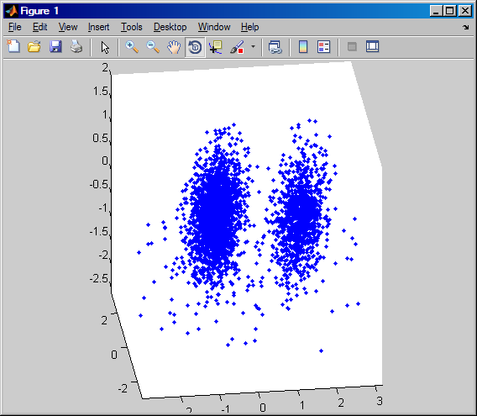
PCA on cluster1
By using the first three columns of the principal component scores on cluster1, we can see there are two separable clusters in the new dimension space.
However, only 60% of the data set's variance is indicated by the first three columns

Slide 9
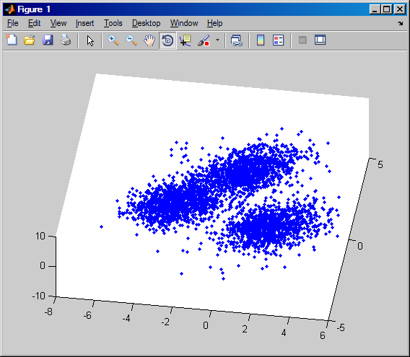
PCA on cluster2
By using the first three columns of the principal component scores on cluster2, we can see there are possibly three separable clusters in the new dimension space.
However, only 66% of the data set's variance is indicated by the first three columns

Slide 10
The initial analysis of using the clustering methods available in Weka:
Clustering Method | clusters % | Clusters (number) | Time (min)
SimpleKMeans | 0 2314 ( 67%) | 2 | < 1
 | 1 1126 ( 33%)
Cobweb | 0 3440 (100%) | 1 | 1
DBScan | 0 3407 (100%) | 1 | 2
EM | failed to produce results in 1 hr
FarthesFirst | 0 3374 ( 98%) | 2 | <<1
 | 1 66 ( 2%)
FilteredCluster | 0 2314 ( 67%) | 2 | <1
 | 1 1126 ( 33%)
HeierarchicalClusterer | failed to produce results in 1 hr
MakeDensityBasedCluster | 0 2328 ( 68%) | 2 | <1
 | 1 1112 ( 32%)
OPTICS | results in graph
sIB | 0 3440 (100%) | 1 | 1
Xmeans | 0 535 ( 16%) | 4 | <1
 | 1 583 ( 17%)
 | 2 1114 ( 32%)
 | 3 1208 ( 35%)
There are three methods who give good results:
1- SimpleKmeans
2- FilteredCluster
3- MakeDensityBasedCluster
All these methods produced 2 classes with 67% and 33%
Xmeans method produced incorrect classes (4 classes).
Other group could not get results in one hour

Slide 11
Neural Classification
The Bayesian classifier in Weka yields good results
  On classify1, 66% of the data was used for training and the remainder was used for testing.
  Almost 95% of the data was correctly classified.
    Took 0.22 seconds to build a Bayes model in Weka
  On classify2, the split between training data and testing data were the same for classify1.
  90% of the data was correctly classified.
    Took 0.72 seconds to build a Bayes model for classify2.

Slide 12
Future Work
It is intended to …
  With Weka, use multiple algorithms on all data sets to find the optimal solution (number of classifiers for cluster data sets and best model for classification data sets).
  Use various discretization algorithms, including CAIM, to improve these preliminary results.
  Use feature selection to eliminate noise in the data where applicable.
  Use the classification model to verify findings in the cluster data set.

Slide 13
Questions

